Slide 1

ELURU COLLEGE OF ENGINEERING AND TECHNOLOGY DEPARTMENT OF COMPUTER SCIENCE AND ENGINEERING INTELLIGENT ARCHITECTURE FOR DETECTING ADVANCED PERSISTENT ATTACKS IN ENTERPRISE ENVIRONMENTS
PROJECT GUIDED BY:
P. Spandana
Assistant Professor
Dept. of CSE
B.Tech, M.Tech
Team members:
R.Uma Satya Santosh (22JD1A05A0)
Sk.Abdul Hafeez (22JD1A05A5)
Y.Prasanthi (22JD1A05C1)
P.Harika (22JD1A0586)

Slide 2
ABSTRACT
Enterprise networks face increasingly sophisticated and persistent cyberattacks that often evade traditional intrusion detection systems. This paper introduces RANK (Robust AI-assisted Network Knowledge), an end-to-end architecture leveraging artificial intelligence to detect Advanced Persistent Threats (APTs) and other stealthy attacks in real time. RANK integrates multiple layers of detection, including anomaly detection, behavior profiling, and contextual analysis, within a scalable and modular framework. At its core, RANK utilizes a hybrid AI approach combining deep learning for traffic pattern recognition and graph-based analysis to model and track lateral movements across network entities. The system is designed to learn from evolving threats using continual learning mechanisms and adapt to dynamic enterprise environments with minimal human supervision.

Slide 3
INTRODUCTION
The increasing complexity and scale of enterprise networks have made them prime targets for persistent and sophisticated cyberattacks, such as Advanced Persistent Threats (APTs). These threats often evade traditional security mechanisms by leveraging stealth, lateral movement, and prolonged dwell times. As organizations rely more heavily on digital infrastructure, the need for intelligent, adaptive, and comprehensive security solutions has become more urgent than ever.

Slide 4
OBJECTIVE
The objective of this project is to develop an AI-based intelligent architecture that can detect Advanced Persistent Threats in enterprise networks by analyzing network behavior, traffic patterns, and attacker movements.
To monitor Enterprise network traffic continuously
To analyze attacker behavior and network patterns
To develop an adaptive security system

Slide 5
SCOPE
While RANK demonstrates promising results, several areas merit further investigation to improve its capabilities. First, enhancing explainability within the AI decision-making process remains critical to increase trust and transparency for security analysts. Incorporating techniques such as SHAP (SHapley Additive exPlanations) or LIME (Local Interpretable Model-Agnostic Explanations) could help bridge this gap.

Slide 6
LITERATURE SURVEY
1. Motivation for Persistent Attack Detection
Traditional security systems often fail to detect Advanced Persistent Threats (APTs) due to their stealthy and prolonged nature.
RANK addresses this gap by providing continuous monitoring and adaptive learning to identify slow, sophisticated attacks that evade signature-based and rule-based systems.
2. End-to-End AI Architecture
RANK employs an end-to-end architecture that integrates data collection, feature extraction, machine learning models, and decision-making.

Slide 7
EXISTING SYSTEM
Traditional intrusion detection systems (IDS) in enterprise networks often rely on signature-based or anomaly-based detection techniques. While these methods can detect known threats with a degree of accuracy, they struggle with identifying advanced persistent threats (APTs) that evolve and adapt over time. Most conventional systems operate in a siloed manner, analyzing network data in isolated segments without integrating contextual insights across different layers of the network. Furthermore, these systems often lack real-time processing capabilities and scalability, making them insufficient for modern enterprise environments where data volumes are vast and threats are increasingly sophisticated.

Slide 8
DRAWBACKS
Centralized Databases:
Vulnerable to tampering by administrators.
Single point of failure leads to potential data breaches or manipulation.
No Transparency:
Transactions and ownership details lack public traceability or auditability.
Disputes over land ownership are common due to unclear or falsified records.

Slide 9
PROPOSED SYSTEM
The proposed system, RANK (AI-assisted End-to-End Architecture), introduces a comprehensive and intelligent framework for detecting persistent attacks within enterprise networks. It leverages artificial intelligence and machine learning to provide continuous monitoring, contextual analysis, and adaptive learning from ongoing network behaviors. RANK integrates multiple components, including data collection agents, a centralized processing engine, and AI models that correlate events across time and systems to identify patterns indicative of advanced threats. Unlike traditional methods, RANK offers an end-to-end architecture that not only detects but also anticipates malicious activities by learning from historical data.

Slide 10
ADVANTAGES
1. Tamper-Proof Land Registration
Blockchain technology ensures decentralization and immutability.
Land records cannot be altered or deleted, protecting ownership from fraud.
2. Fraud Detection with AI/ML
Advanced AI models (e.g., LIGHTGBM, XGBOOST, SVM) are trained to detect fraudulent transactions.
The system achieved up to 99.35% accuracy in fraud detection using Ethereum transaction datasets.

Slide 11
HARDWARE REQUIREMENTS
System : i3
Hard Disk : 250 GB
RAM : 4 GB

Slide 12
SOFTWARE REQUIREMENTS
Operating system : Windows Family
Coding Language : Python

Slide 13
MODULES
1. Data Collection Module
2. Preprocessing Module
3. Feature Engineering Module
4. Threat Modeling & Knowledge Base
5. Detection Engine (AI/ML Module)
6. Correlation & Alerting Module
7. Visualization & Reporting Module
8. Feedback & Learning Loop

Slide 14
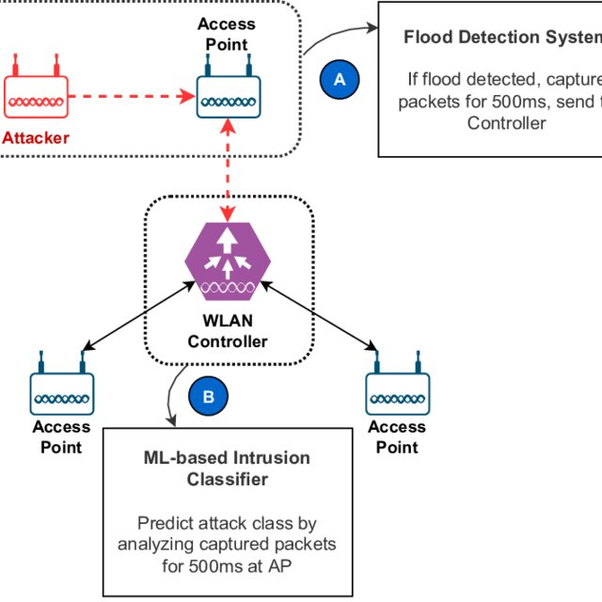
SYSTEM ARCHITECTURE

Slide 15
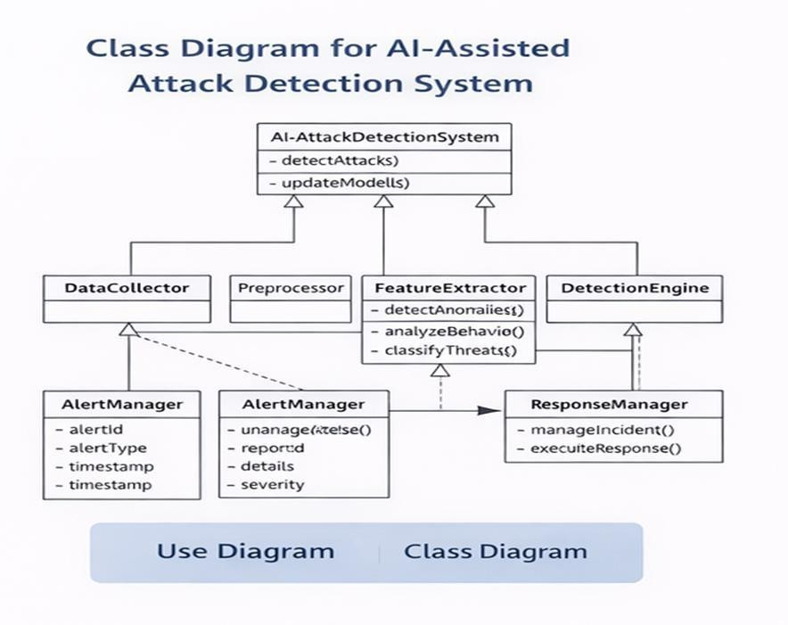
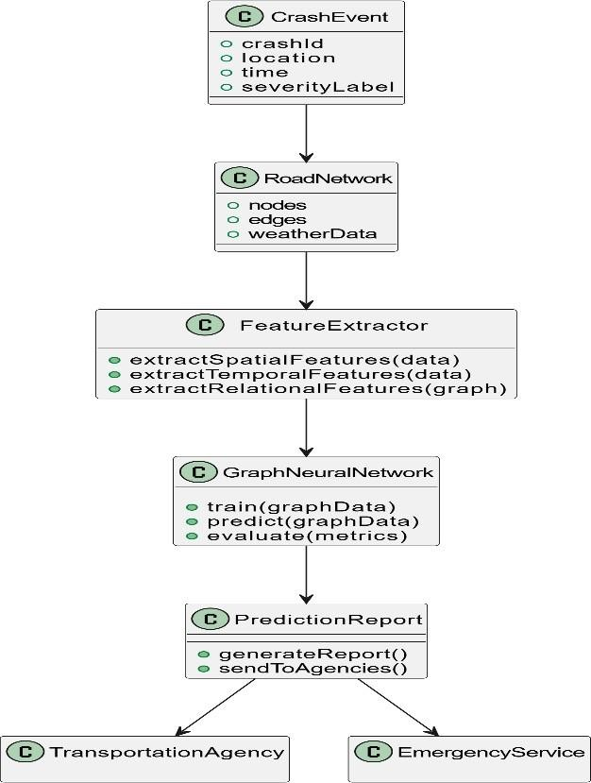
UML
Class Diagram:
A Class Diagram represents the structure of the system by showing classes, their attributes, and methods.
It also illustrates the relationships between different classes in the system.
This diagram helps in understanding how data and functions are organized in the application

Slide 16
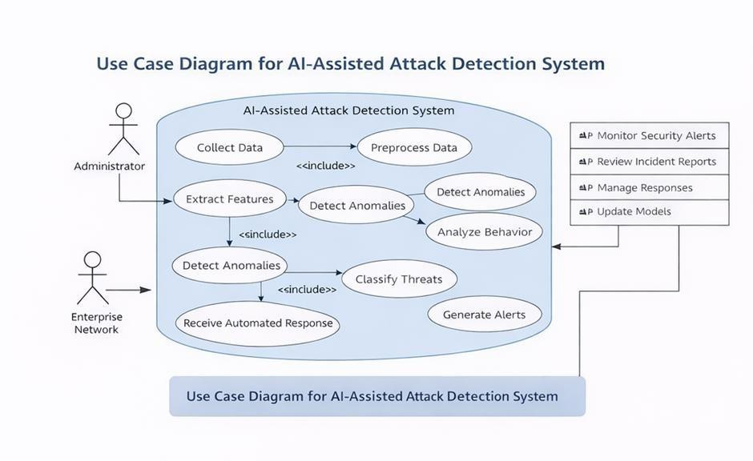
Use case Diagram:
A Use Case Diagram represents the interaction between users (actors) and the system.
It shows the different functionalities provided by the system.
In this project, it illustrates how the user interacts with the system to input accident data and obtain injury severity predictions

Slide 17
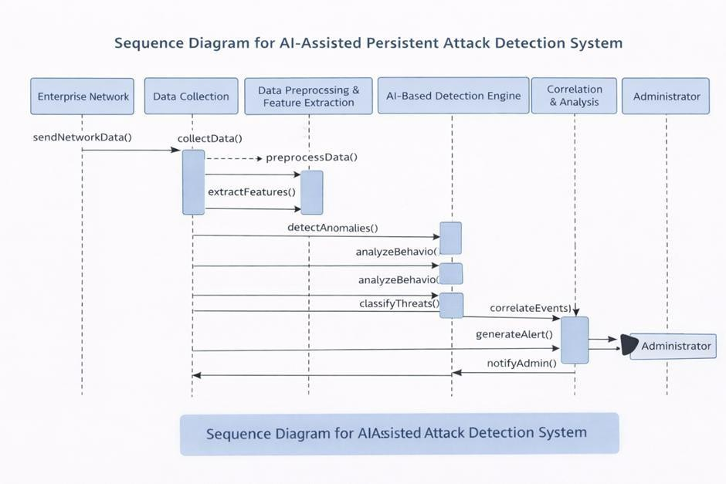
Sequence Diagram:
A Sequence Diagram shows the sequence of interactions between different components of the system over time.
It explains how messages are passed between objects to complete a task.
In this project, it shows the process from user input to injury severity prediction.

Slide 18
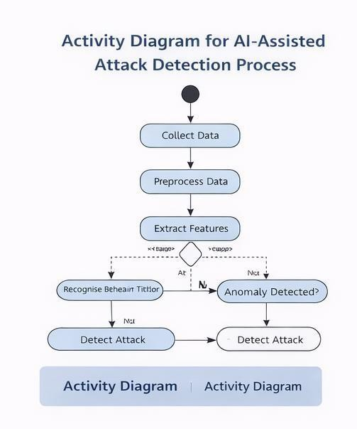
Activity Diagram:
Activity diagrams are graphic representations of workflows of stepwise activities and actions with support for choice, iteration and concurrency.
alIn the Unified Modeling Language, activity diagrams can be used to describe the business and operational step-by- step workflows of components in a system.

Slide 19
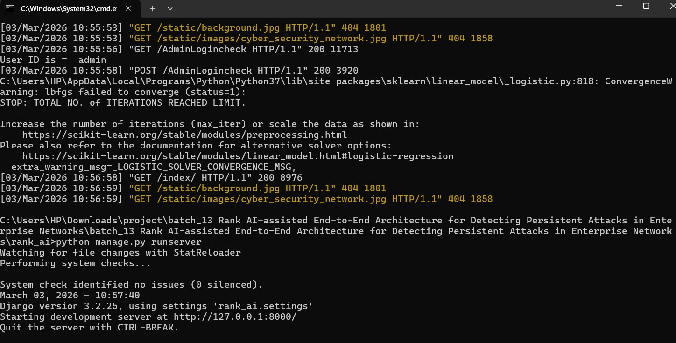

Slide 20
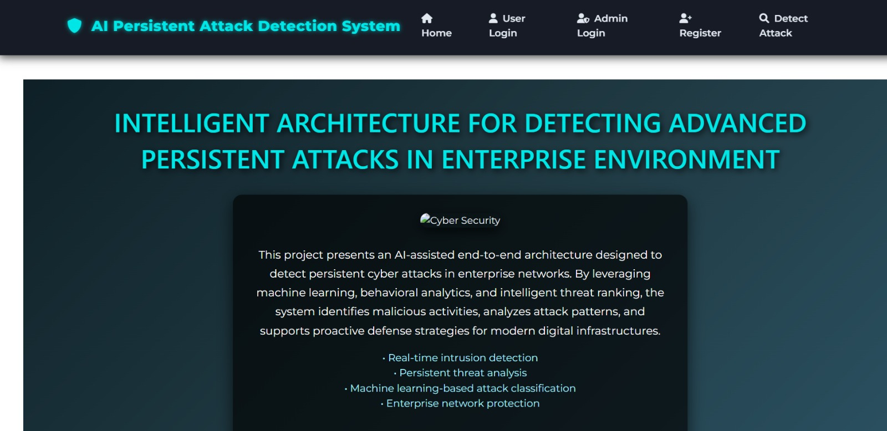

Slide 21
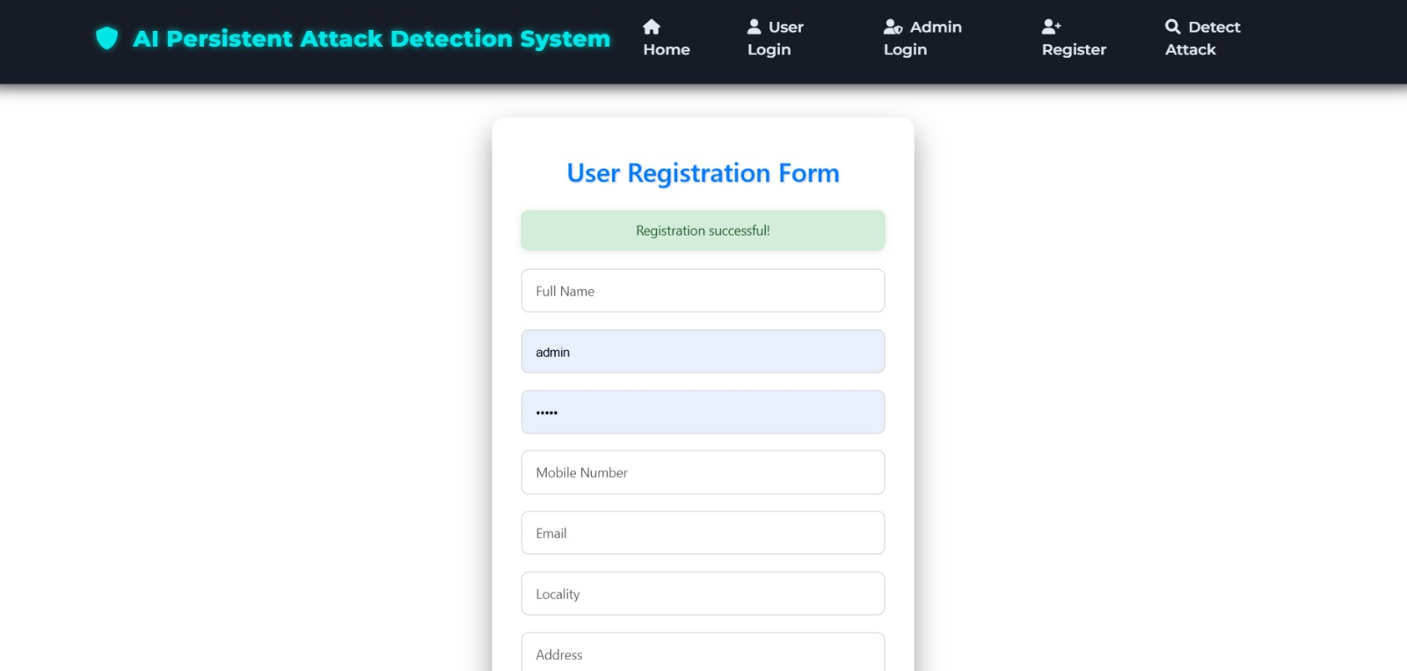

Slide 22
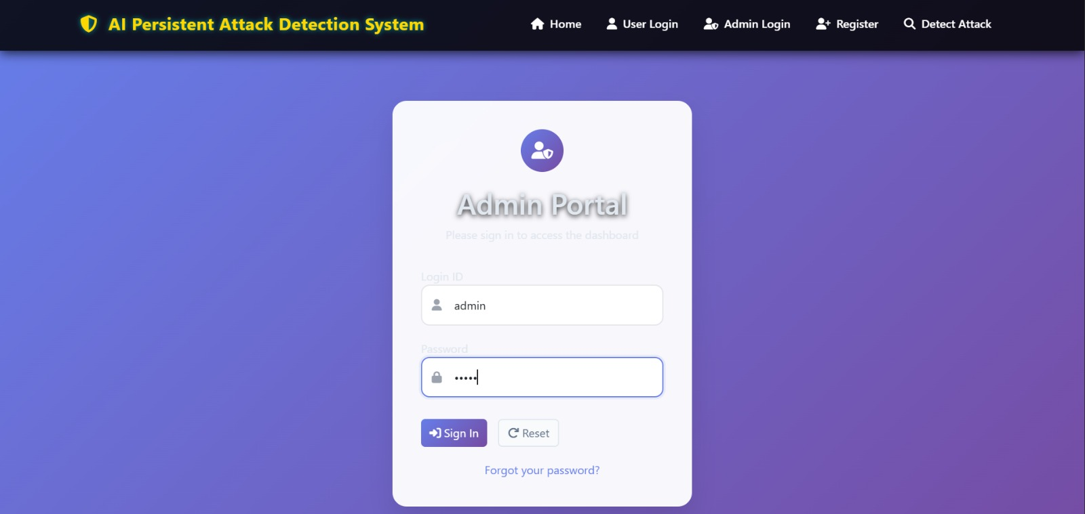

Slide 23
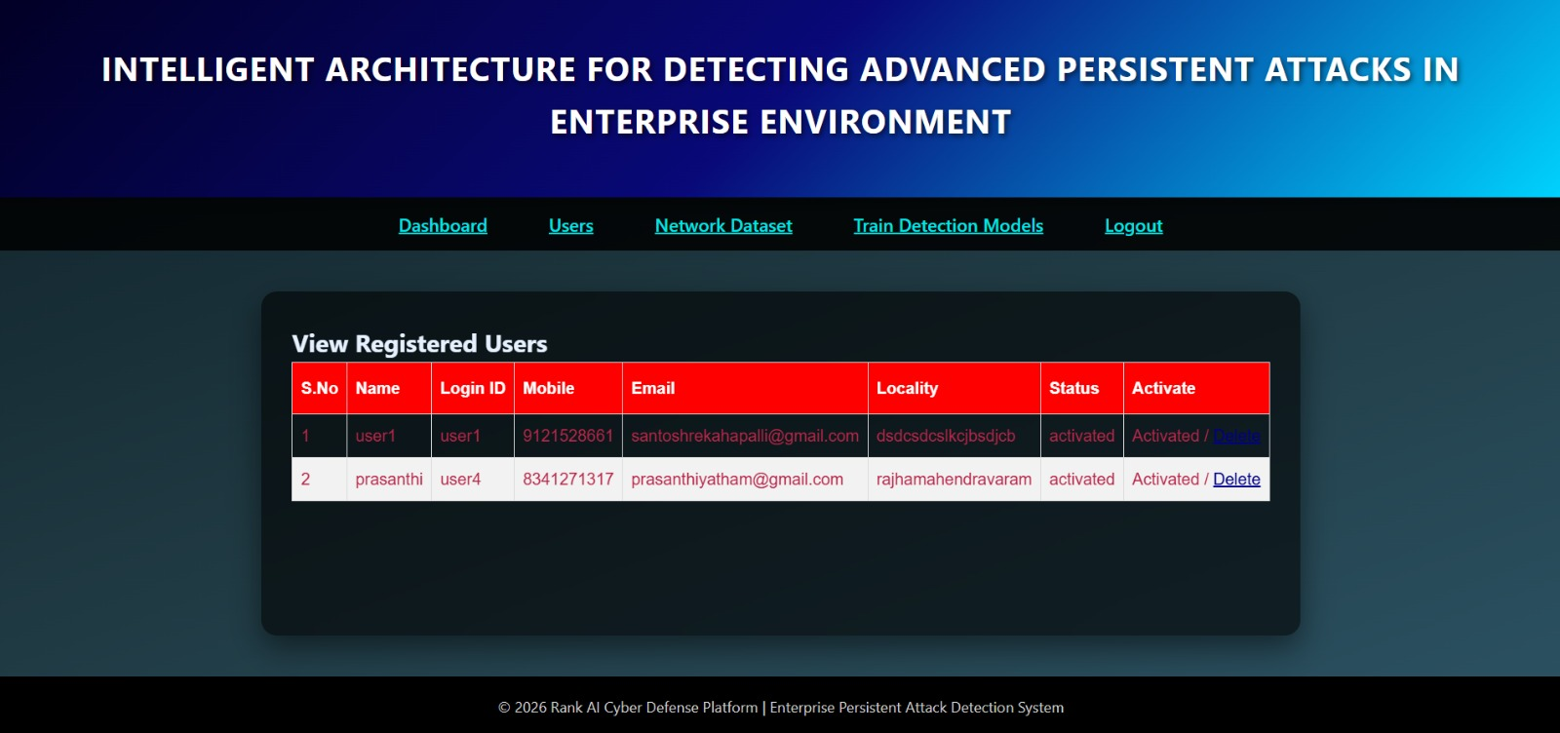

Slide 24
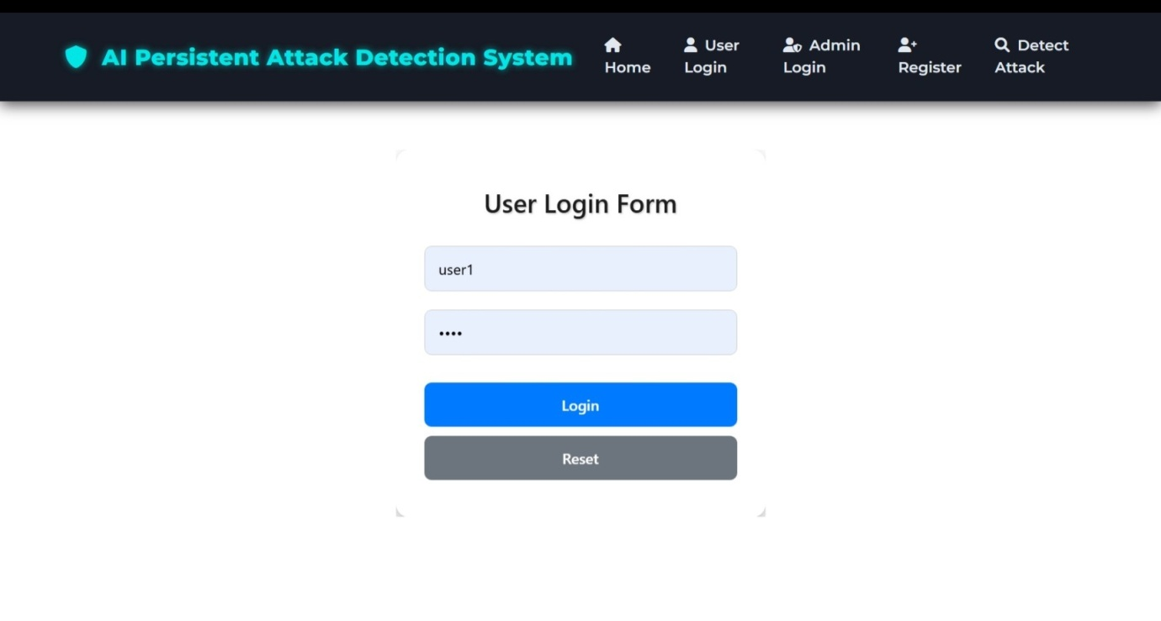

Slide 25
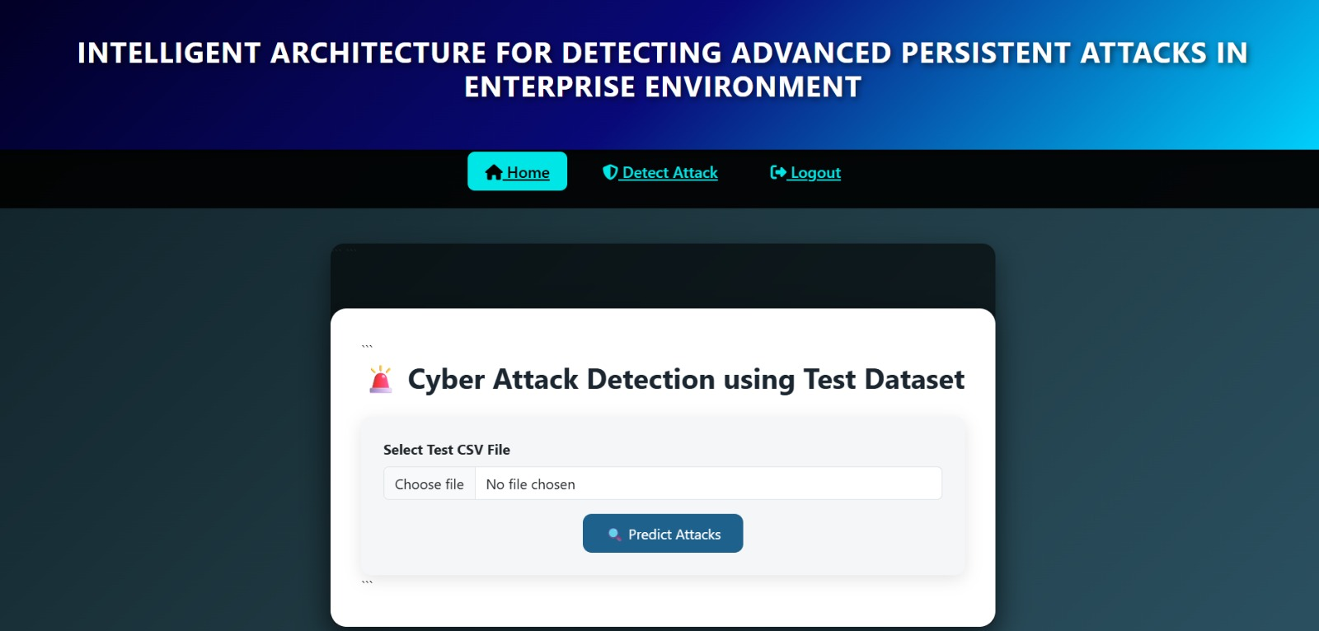

Slide 26
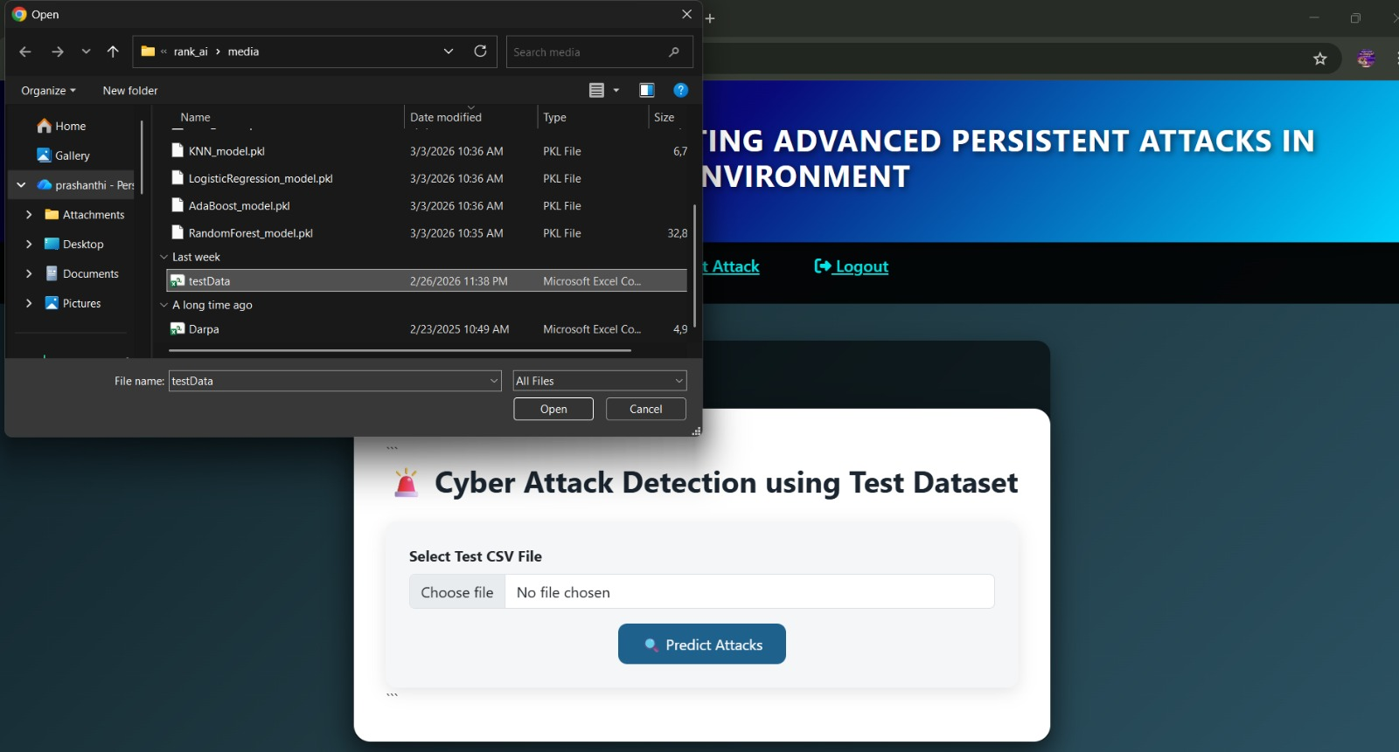

Slide 27
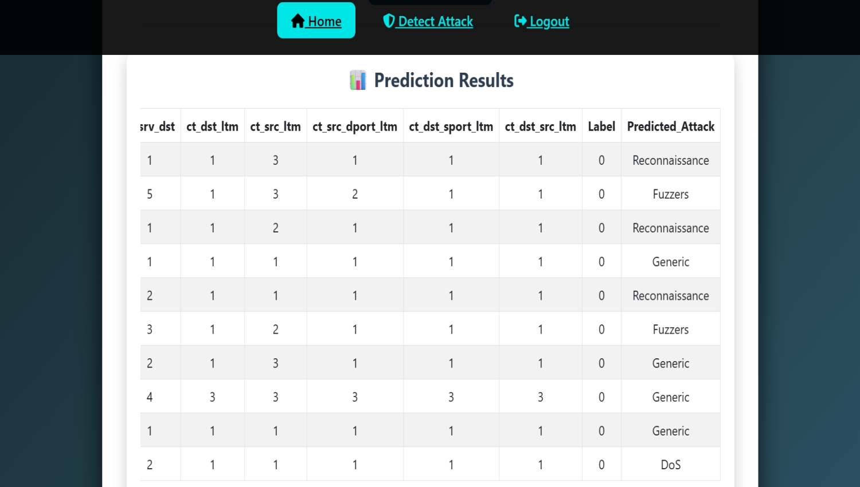

Slide 28
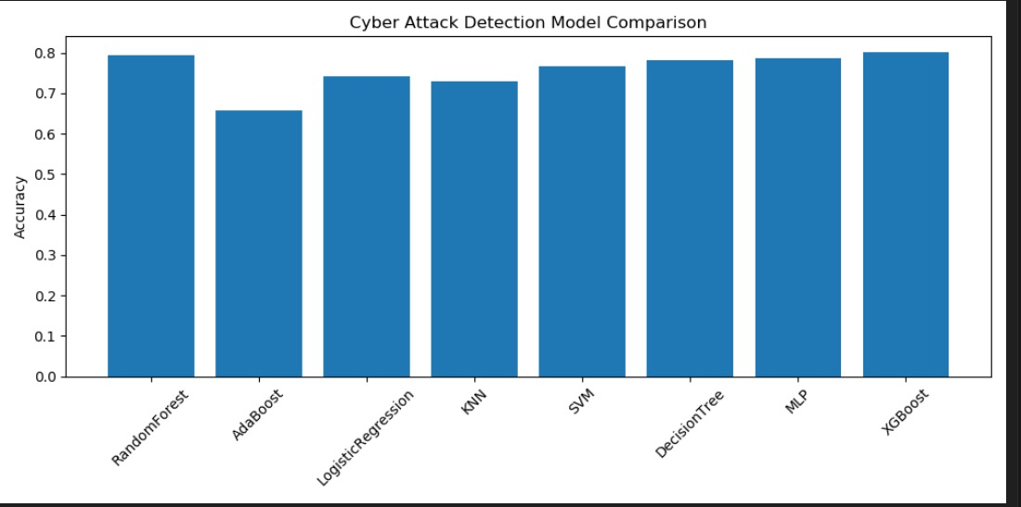

Slide 29
CONCLUSION
In this paper, we introduced RANK, an AI-assisted end-to-end architecture designed to detect persistent attacks in enterprise networks. By integrating deep learning models with behavioral analysis and network flow intelligence, RANK enhances the detection of stealthy and long-duration attacks such as Advanced Persistent Threats (APTs). The architecture leverages a multi-layered approach that incorporates traffic pre-processing, feature extraction, anomaly detection, and threat classification in a scalable and modular fashion. Our evaluation using simulated and real-world datasets demonstrates RANK’s ability to identify complex attack patterns with higher precision and recall compared to traditional intrusion detection systems.

Slide 30
REFERENCE
• J. Shukla, A. Kumar, and R. Hoda, "A survey on intrusion detection systems and techniques," Procedia Computer Science, vol. 167, pp. 636–645, 2020.
• N. Moustafa and J. Slay, "UNSW-NB15: A comprehensive data set for network intrusion detection systems," Military Communications and Information Systems Conference (MilCIS), Canberra, Australia, pp. 1–6, 2015.
• D. E. Denning, "An intrusion-detection model," IEEE Transactions on Software Engineering, vol. SE-13, no. 2, pp. 222–232, 1987.
• T. Chen et al., "Machine learning based mobile malware detection using highly imbalanced network traffic," Information Sciences, vol. 433–434, pp. 346–364, 2018.

Slide 31
THANK YOU

